Slide 1
Basic Statistics and Probability
AI and Data Science
Presented By:
Muhammad Sanan Qureshi

Slide 2
Outline
Mean, Median and Mode
Range, Variance, and Standard Deviation
Simple Probability
Expected Value
Dependent and Independent Event

Slide 3
Mean
Day | Number of Products Sold
1 | 15
2 | 18
3 | 14
4 | 20
5 | 22
6 | 17
7 | 16
8 | 21
9 | 19
10 | 23
The mean of all the numbers in a dataset is its average. It is a central tendency measure. that is calculated by adding up all the values in a dataset and dividing by the total number of values.*
Add all the values in the dataset and divide by the number of values.
Q1. Over ten days, a corporation has tracked the quantity of goods sold every day. The following statistics are provided:
*Credit goes to geeksforgeeks

Slide 4
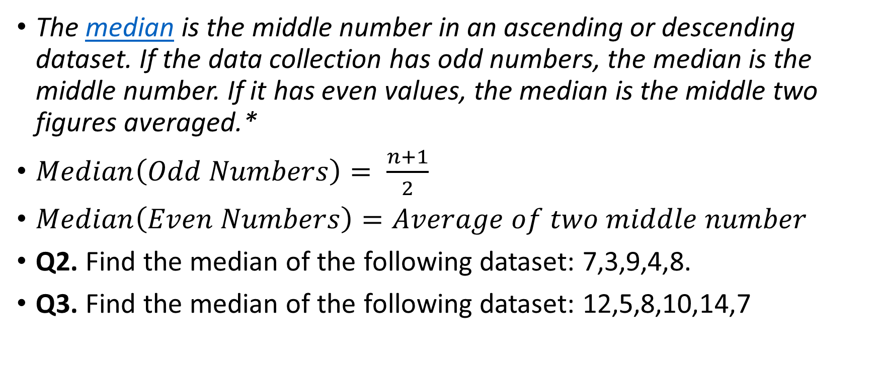
Median
The median is the middle number in an ascending or descending dataset. If the data collection has odd numbers, the median is the middle number. If it has even values, the median is the middle two figures averaged.*
$Median\left(Odd Numbers\right)= \frac{n+1}{2}$
$Median\left(Even Numbers\right)=Average of two middle number$
Q2. Find the median of the following dataset: 7,3,9,4,8.
Q3. Find the median of the following dataset: 12,5,8,10,14,7
*Credit goes to geeksforgeeks

Slide 5
Mode
The value that shows up in a dataset the most often is called its mode. One mode, several modes, or none at all if no number repetitions can exist in a dataset.*
Q4. The following data shows the ages of participants in a workshop: 21,23,25,21,22,25,21,24,23,22,21,23,24,22,23.
*Credit goes to geeksforgeeks

Slide 6
Practice Questions
1. The ages of a group of friends are: 25, 30, 28, 32, and 35. Find the mean age of the group.
2. The test scores of a class are: 65, 72, 78, 85, 90. Find the median score.
3. A football team played 10 matches. The number of goals scored by the team are: 2, 3, 1, 4, 2, 3, 2, 5, 4, 2. Find the mode.
4. The weights of five students in a class are: 50 kg, 55 kg, 60 kg, 65 kg, and 70 kg. Find the mean weight.
5. The number of siblings of students in a school are: 0, 1, 2, 1, 3, 2, 1, 2, 1, 0. Find the mode.
6. The heights of students in a class are: 150 cm, 155 cm, 160 cm, 165 cm, and 170 cm. Find the median height.
7. The monthly salaries (in $) of employees in a company are: 3000, 3500, 4000, 4500, and 5000. Find the mean salary.
8. The ages of a group of people are: 25, 30, 35, 40, 45, 50, 55. Find the median age.
9. The temperatures (in °C) recorded over a week are: 20, 22, 25, 24, 26, 23, 21. Find the mean temperature.
10. The number of hours spent studying by students in a week are: 2, 3, 4, 2, 5, 3, 2, 4, 3, 3. Find the mode

Slide 7
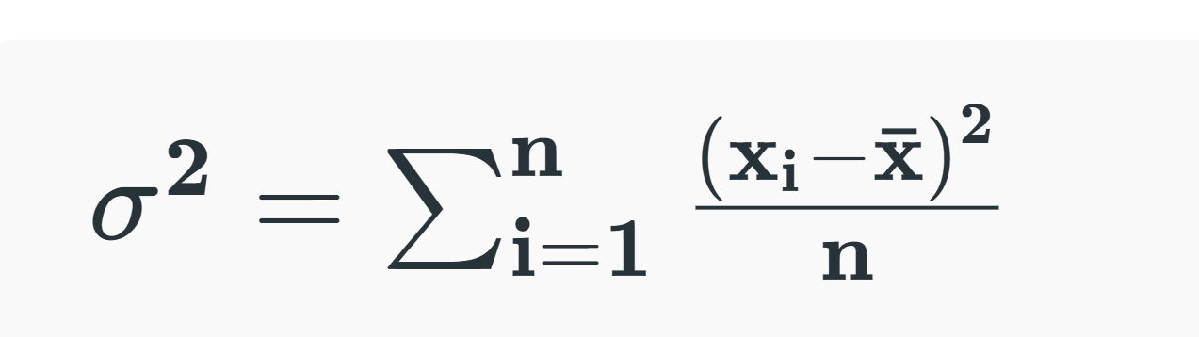
Variance
Variance is defined as "The measure of how far the set of data is dispersed from their mean value". Variance is represented with the symbol σ². In other words, we can also say that the variance is the average of the squared difference from the mean.
https://youtu.be/jx8a_jdlxAQ?si=Rn38vw4bUNDyxQgB

Slide 8
Continue..
https://www.mathsisfun.com/data/standard-deviation.html

Slide 9
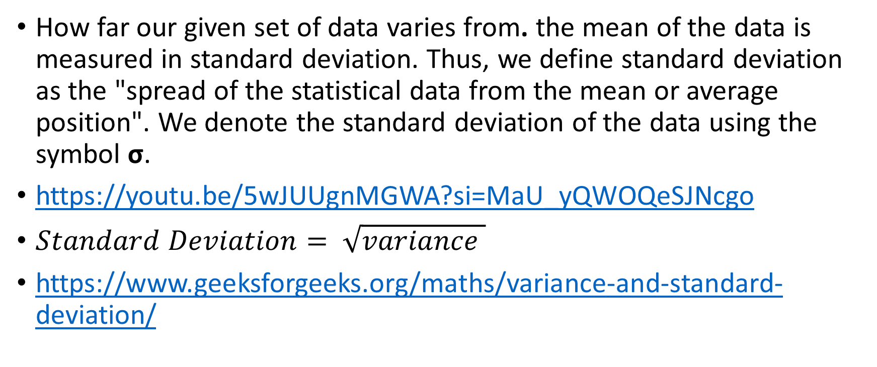
Standard Deviation
How far our given set of data varies from. the mean of the data is measured in standard deviation. Thus, we define standard deviation as the "spread of the statistical data from the mean or average position". We denote the standard deviation of the data using the symbol σ.
https://youtu.be/5wJUUgnMGWA?si=MaU_yQWOQeSJNcgo
$Standard Deviation= \sqrt{variance }$
https://www.geeksforgeeks.org/maths/variance-and-standard-deviation/

Slide 10
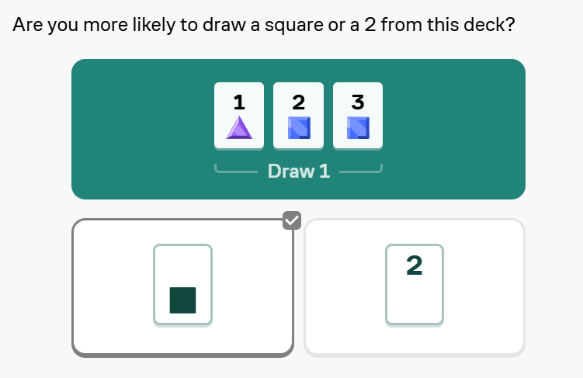
Introduction of Probability

Slide 11
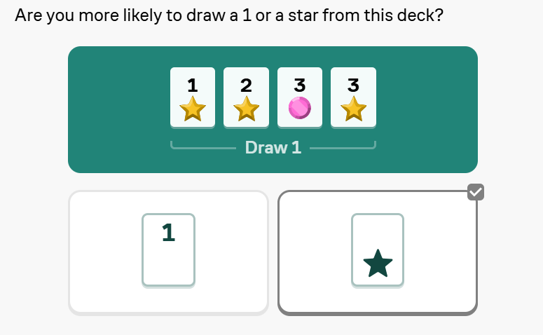
Introduction of Probability

Slide 12
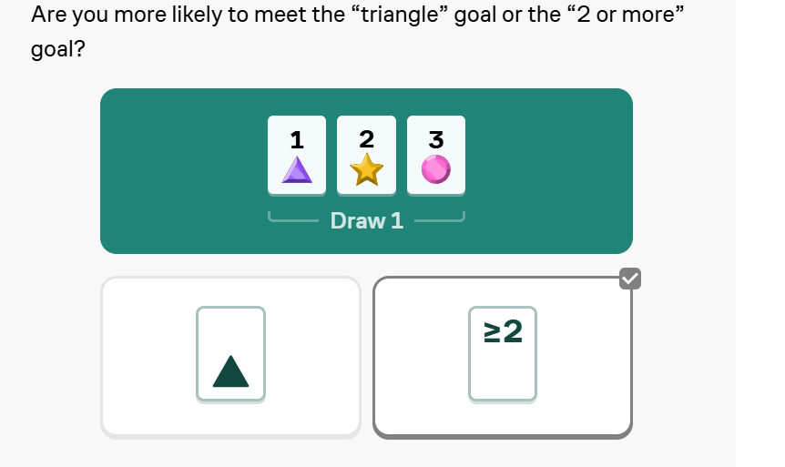
Introduction of Probability

Slide 13
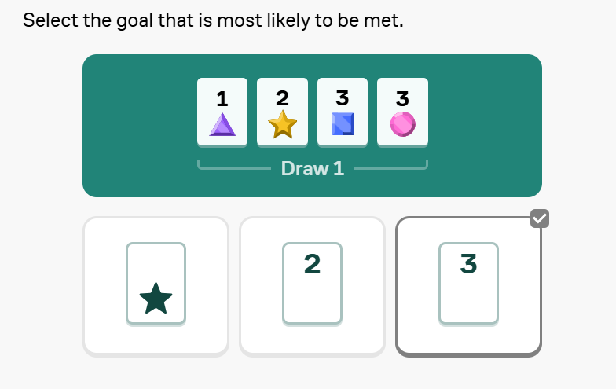
Introduction of Probability

Slide 14
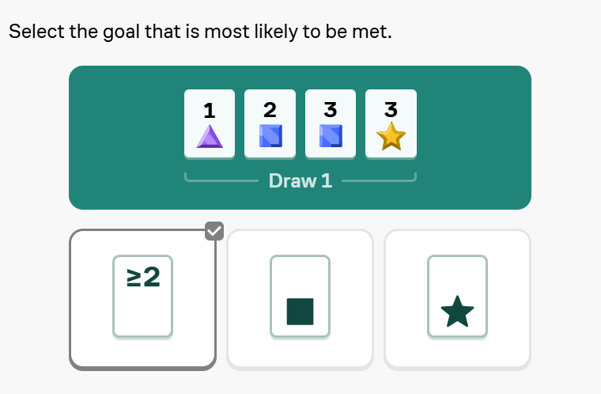
Introduction of Probability

Slide 15
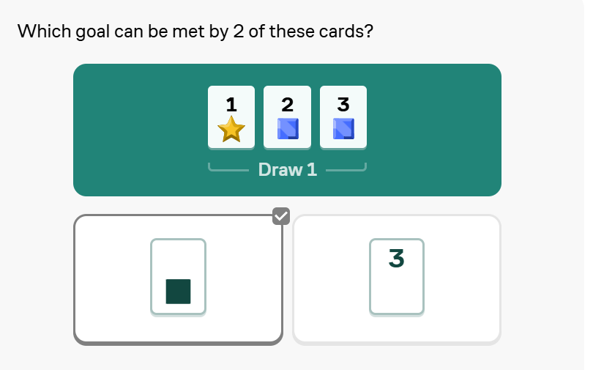
Introduction of Probability

Slide 16
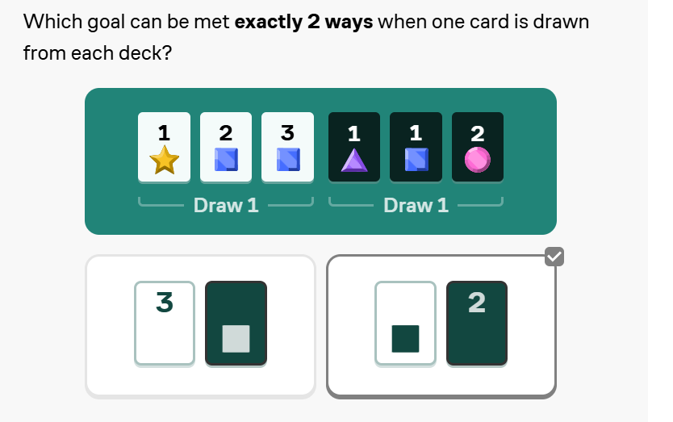
Introduction of Probability

Slide 17
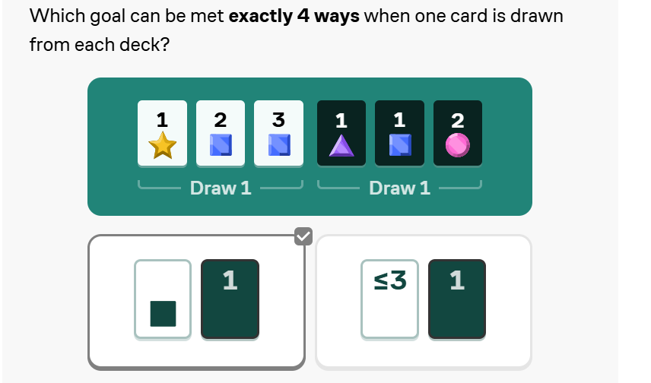
Introduction of Probability

Slide 18
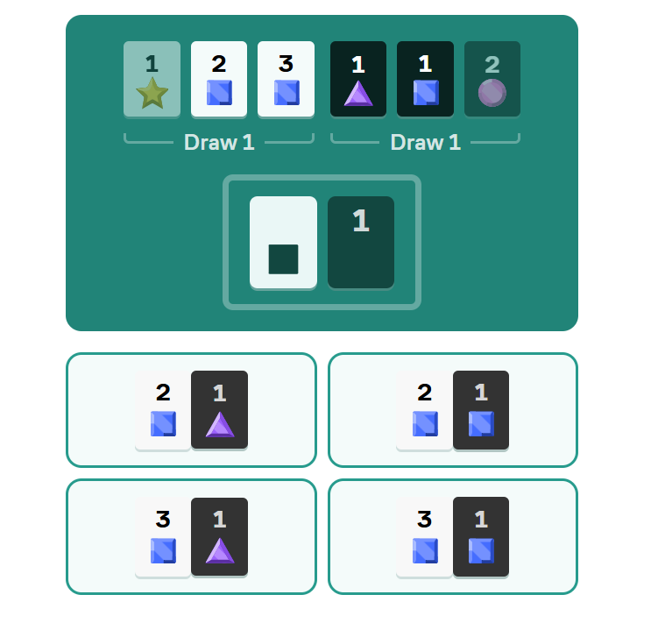
Introduction of Probability

Slide 19
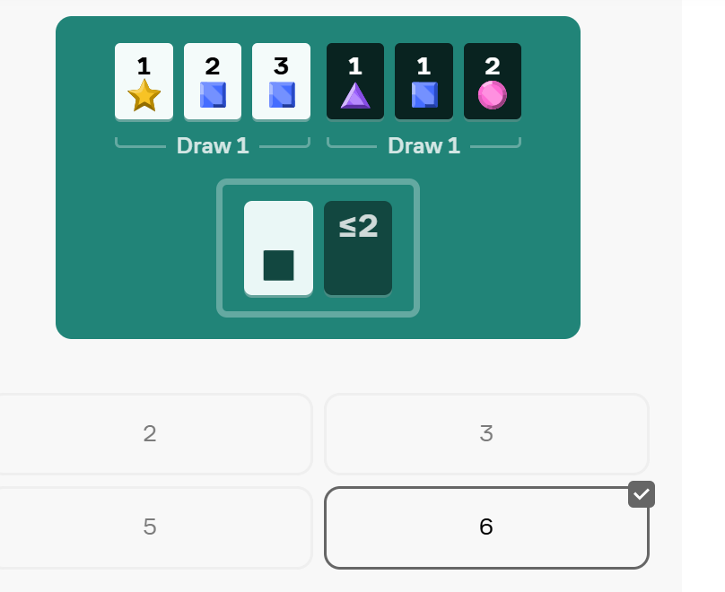
Introduction of Probability

Slide 20
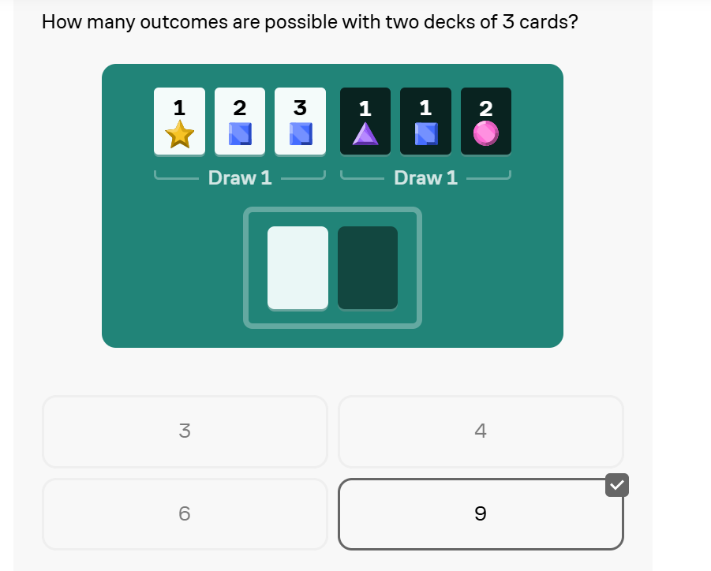
Introduction of Probability

Slide 21
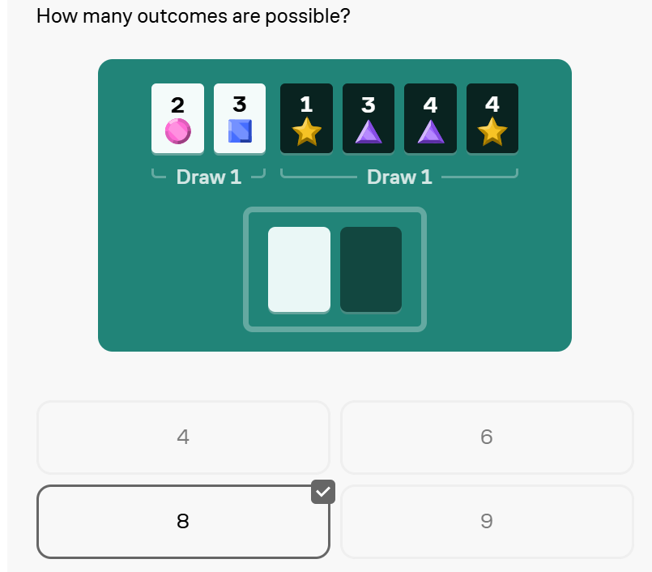
Introduction of Probability

Slide 22
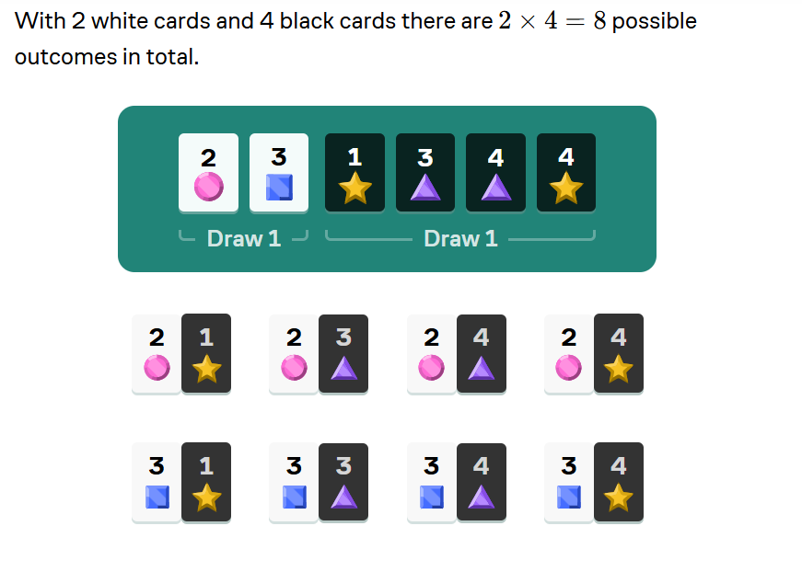
Introduction of Probability

Slide 23
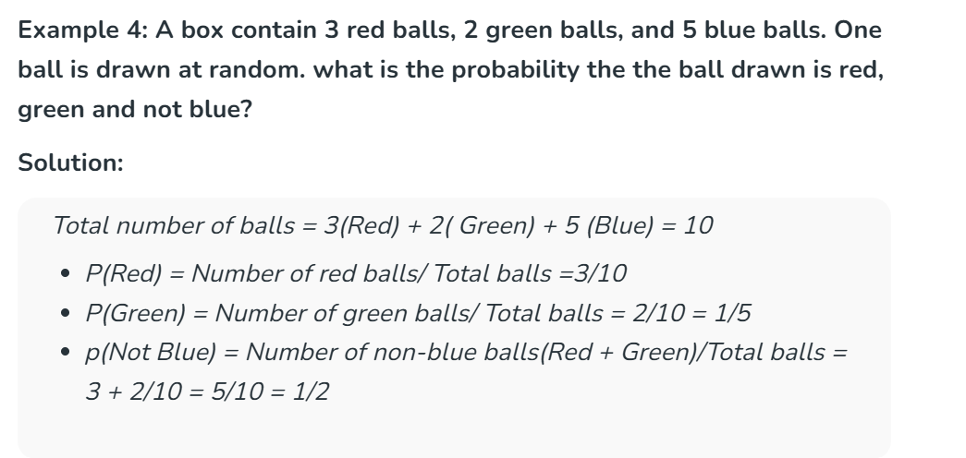
Introduction of Probability

Slide 24
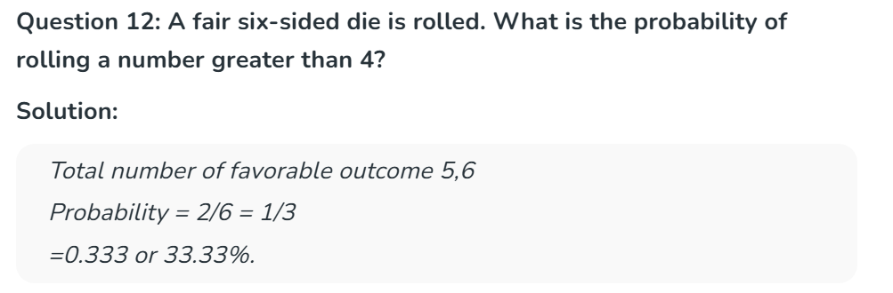
Introduction of Probability

Slide 25
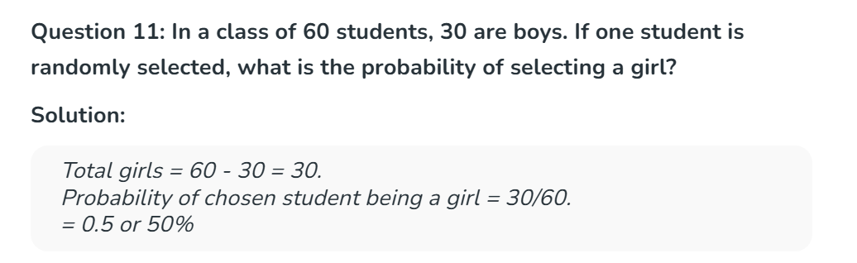
Introduction of Probability

Slide 26
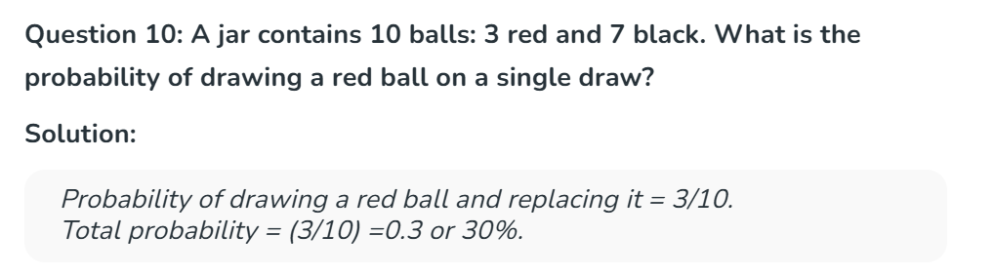
Introduction of Probability

Slide 27
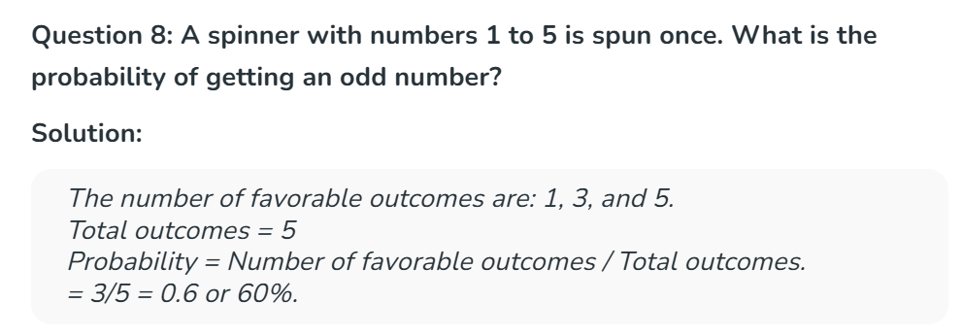
Introduction of Probability

Slide 28
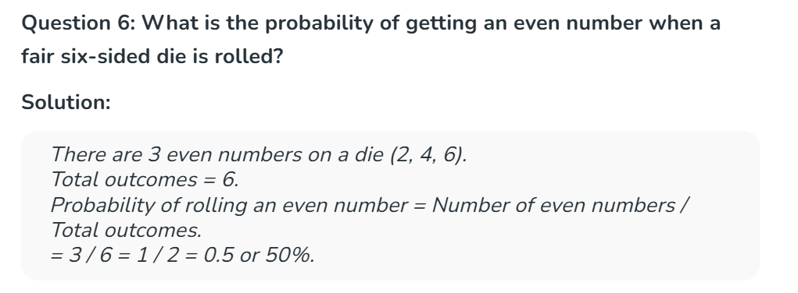
Introduction of Probability

Slide 29
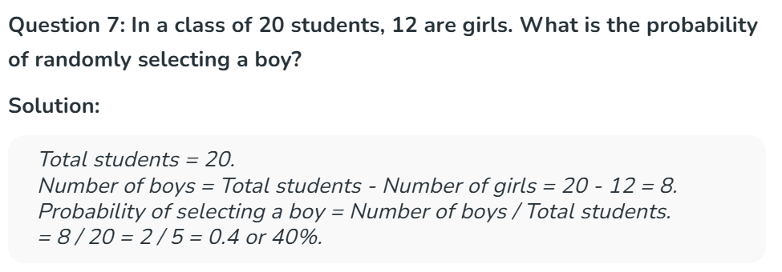
Introduction of Probability

Slide 30
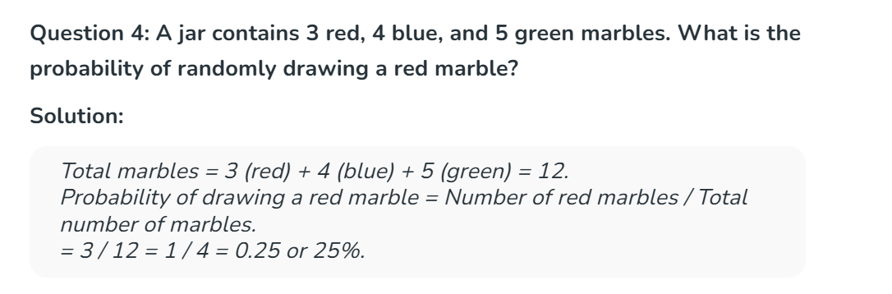
Introduction of Probability

Slide 31
Summary
In this lecture, students learned about major Statistical concepts.

